Slide 1

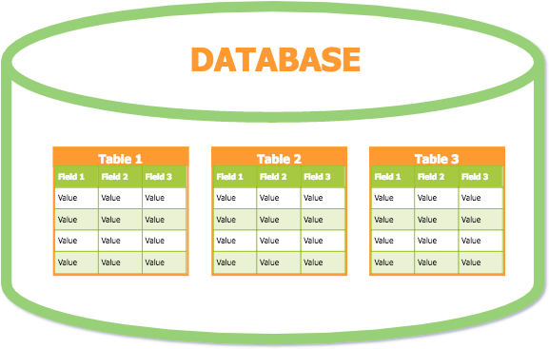
ISAD253SL - Databases
Lesson 10 Data Normalization
1

Slide 2
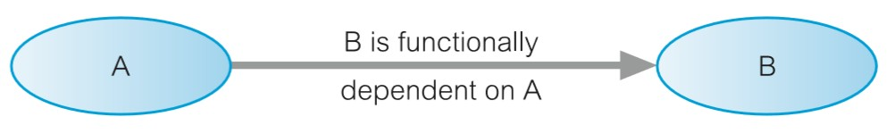
Functional Dependency
A relationship between attributes such that, an attribute ‘B’ is said to be functionally dependent on another
attribute ‘A’, if the value of ‘A’ at all times determines the value for ‘B’.
‘B’ is functionally dependent on ‘A’. ‘A’ functionally determines ‘B’.
‘A’ is called as the Determinant.

Slide 3

Examples
FD1
Ssn → {Ename, Bdate, Address, Dnumber}
FD2
Dnumber → {Dname,Dmgr_ssn}

Slide 4
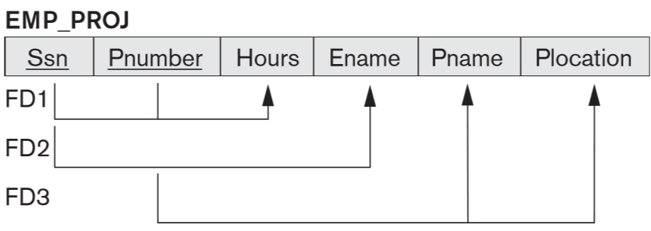
Examples
FD1
{Ssn,Pnumber} → Hours
FD2
Ssn → Ename
FD3
Pnumber → {Pname,Plocation}

Slide 5
Fully Functional Dependency
‘B’ is fully functionally dependent on ‘A’, if it is functionally dependent on ‘A’ and not functionally dependent on any part of ‘A’.
Eg:
StudentId, ModuleCode
Marks
SupplierID, ProdID
Qty

Slide 6
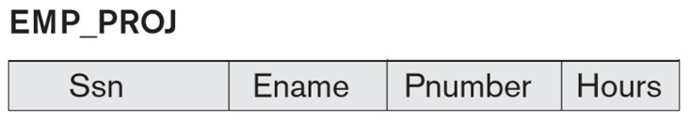
Full Dependency & Partial Dependency
{Ssn, Pnumber} → Hours
a full dependency (neither Ssn → Hours nor Pnumber → Hours holds).
{Ssn, Pnumber} → Ename
Partial dependency because Ssn→Ename holds.

Slide 7
Normalization
This is the process of decomposing unsatisfactory relations (tables that are nor according to the relational model) into smaller relations.
It helps to
eliminate data redundancy
organize data efficiently
reduce potential problems during data operations (insert, update & delete)

Slide 8
Normalization Forms
First Normal Form (1NF)
Second Normal Form (2NF)
Third Normal Form (3NF)
Boyce Codd Normal Form (BCNF)
For a correctly drawn ER/EER diagram and a correct mapping according to relational model, the final relations are in the 3NF.

Slide 9
First Normal Form (1NF)
No composite attributes.
No multi valued attributes.
No nested relations.
The attributes must be atomic and single valued.
If a particular relation is not in 1NF have to decompose it into relevant relations and add the PK of the original relation.

Slide 10
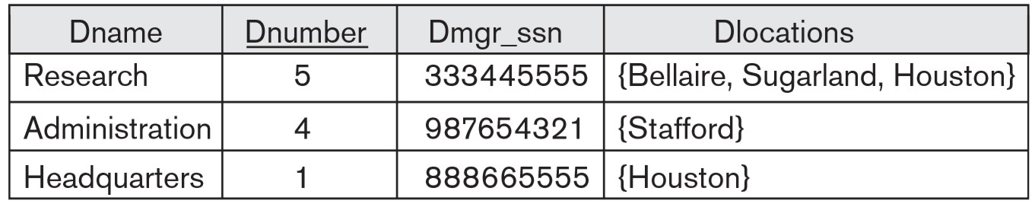
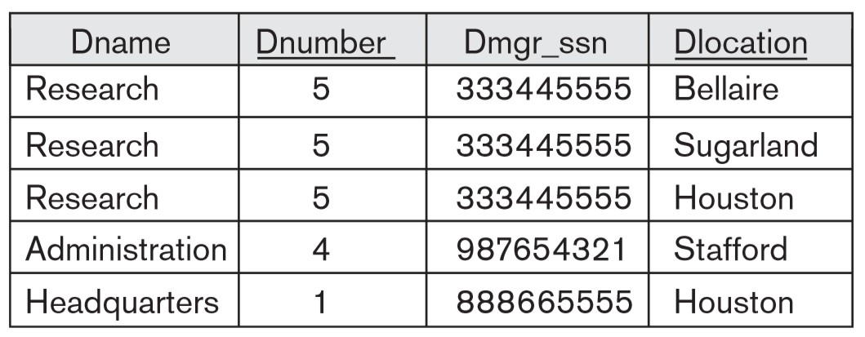
Example 1

Slide 11
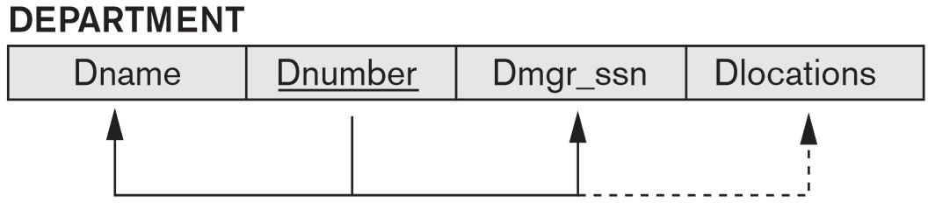
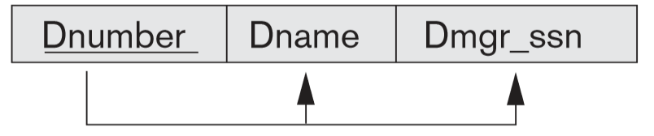
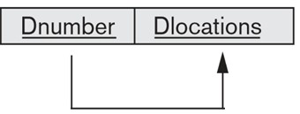
Relation DEPARTMENT is not in 1NF.
According to 1NF:
DEPARTMENT
LOCATIONS

Slide 12
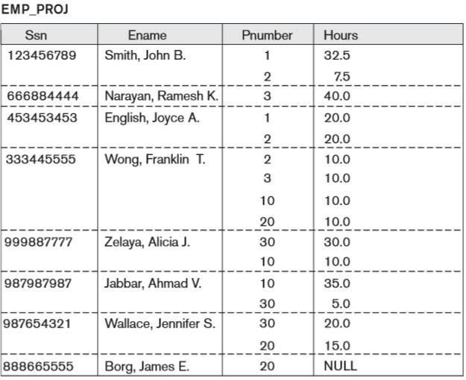

Slide 13

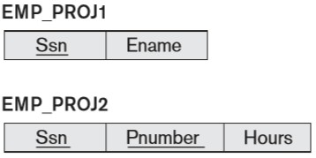
Normalizing nested relations into 1NF
EMP_PROJ (Ssn, Ename, {PROJS(Pnumber, Hours)})

Slide 14
Second Normal Form (2NF)
Based on the concept of fully functional dependency.
A relational schema ‘R’ is in 2NF, if every non-key attribute ‘A’ in ‘R’ is fully functionally dependent on the primary key of ‘R’.
A relation that is in 1NF and every non-primary key attribute is fully functionally dependent on the primary key.

Slide 15
Second Normal Form (2NF)
2NF involves the removal of partial dependencies.
If a partial dependency exists, remove the partially dependent attribute(s) from the relation by placing them in a new relation along with a copy of their determinant.

Slide 16
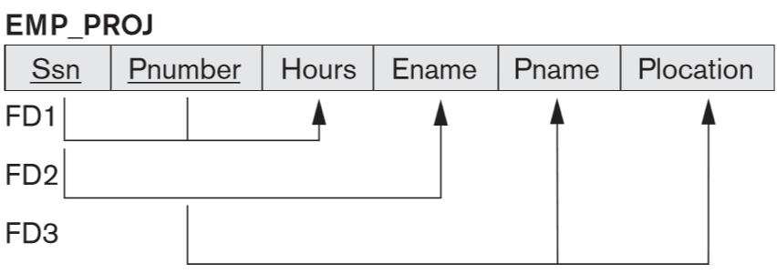
Example
This relation is in 1NF but is not in 2NF.
The functional dependencies FD2 and FD3 partially dependent on the primary key {Ssn,Pnumber}

Slide 17
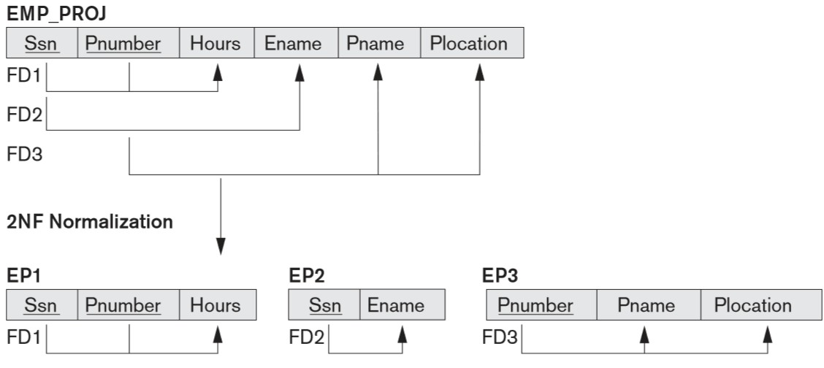
Example

Slide 18
Transitive Dependency
If x, y and z are attributes, and if
x y
y z
Then ‘z’ is transitively dependent on x.
x z

Slide 19
Third Normal Form (3NF)
3NF is based on the concept of transitive dependency.
Condition A:
– A relational schema is in 3NF only if it is in 2NF and every non key attribute is non transitively dependent on the PK.
Condition B:
– If a functional dependency X
then
‘X’ must be a super key
Or
A exists in a relation R,
‘A’ must be a prime attribute when ‘X’ is not a super key.

Slide 20
Third Normal Form (3NF)
A relation that is in 1NF and 2NF and in which no non- primary key attribute is transitively dependent on the primary key.
3NF involves the removal of transitive dependencies.
If a transitive dependency exists, remove the transitively dependent attribute(s) from the relation by placing the attribute(s) in a new relation along with a copy of the determinant.

Slide 21
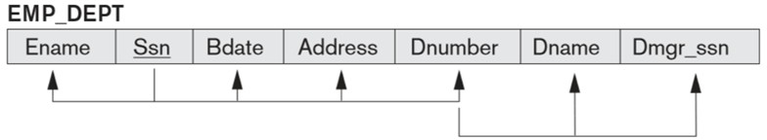
Example
Ssn → {Ename, Bdate, Address, Dnumber}
Dnumber → {Dname, Dmgr_ssn}
Ssn → {Dname, Dmgr_ssn}

Slide 22
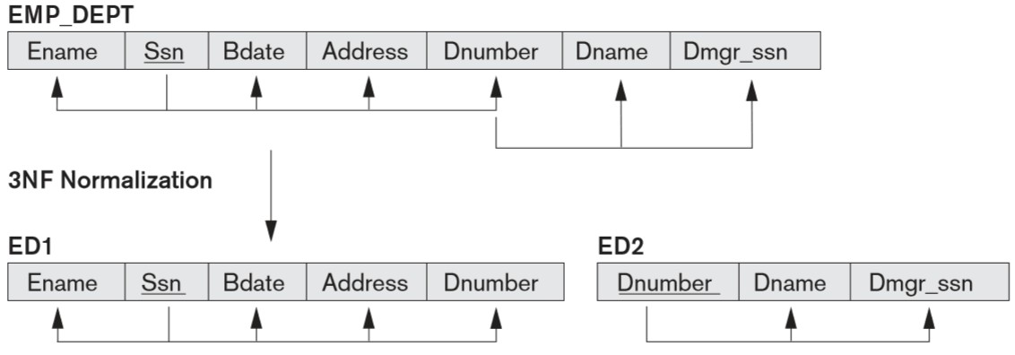
Example

Slide 23
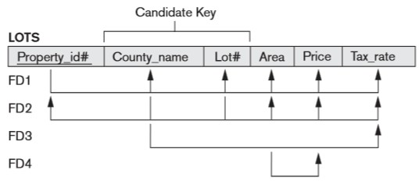
Exercise
Normalize the following LOTS relation into 2NF and 3NF.

Slide 24
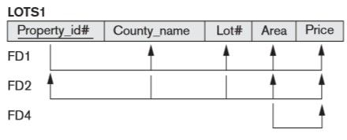
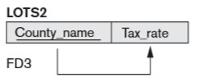
2NF

Slide 25
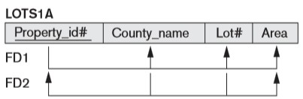

3NF

Slide 26
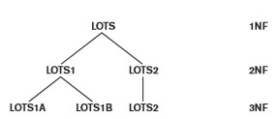
Summary of LOTS

Slide 27
Boyce Codd Normal Form (BCNF)
A relational schema ‘R’ is in BCNF if whenever a functional dependency X→A holds in R, then X is a super key of R.
BCNF is a simpler form of 3NF, but it was found to be stricter than 3NF.
Every relation in BCNF is also in 3NF but a relation in 3NF is not in BCNF.

Slide 28
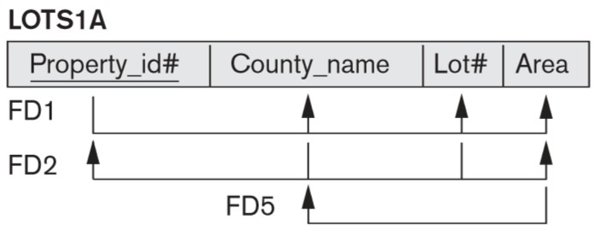
Example
Assumption:
Candidate Key : Country_name + Lot#
This is in 3NF because Country_name is a prime attribute. But not in BCNF.

Slide 29
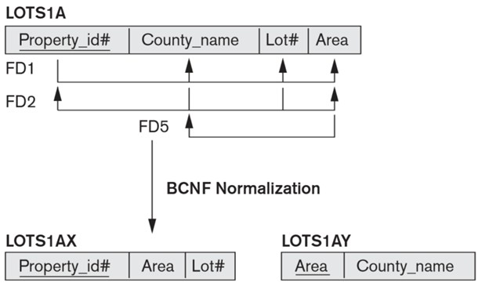

Slide 30
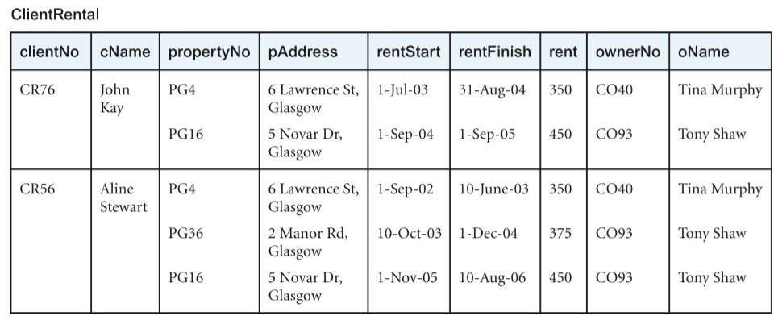
Example 2
Un-normalized Data

Slide 31
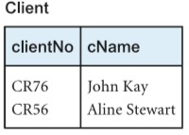
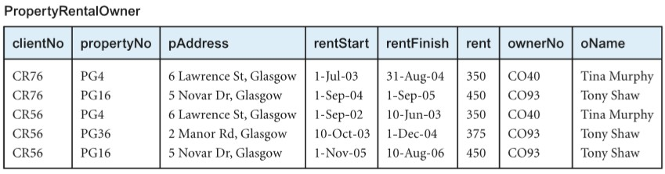
1NF

Slide 32
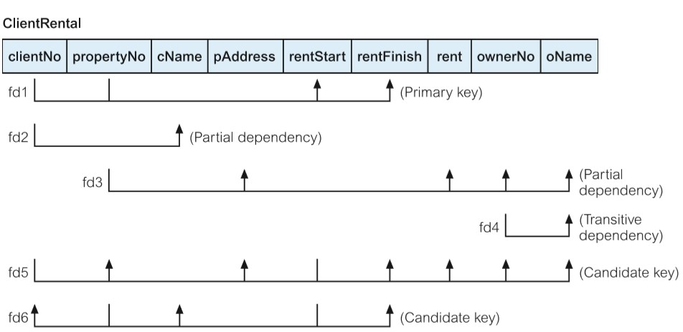
Functional Dependencies

Slide 33
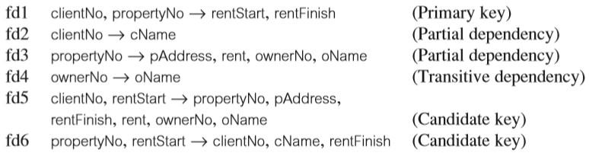
Functional Dependencies

Slide 34

2NF

Slide 35
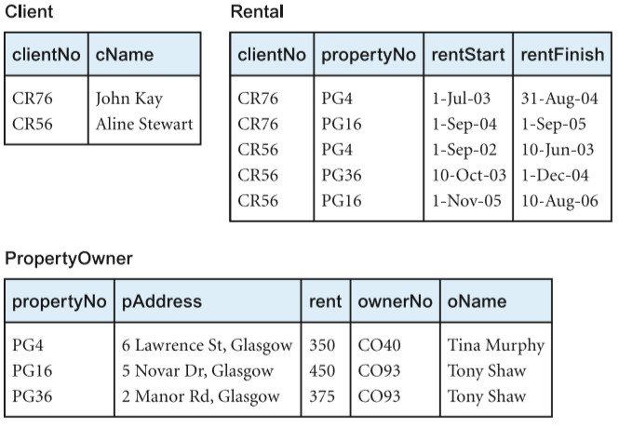
2NF

Slide 36
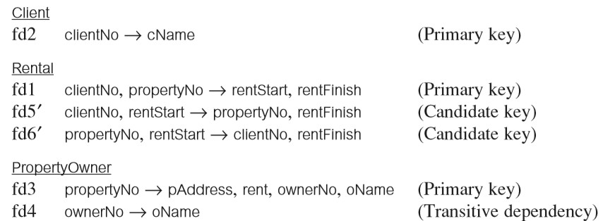
Functional Dependencies

Slide 37

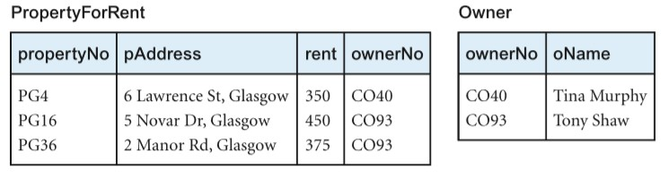
3NF

Slide 38
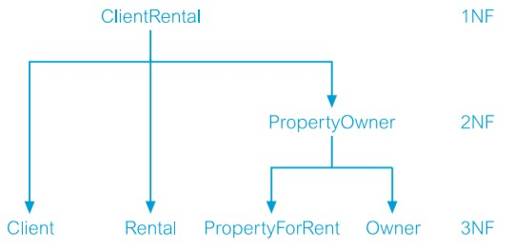
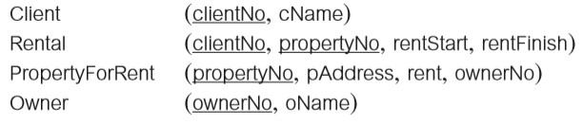
3NF relations

Slide 39
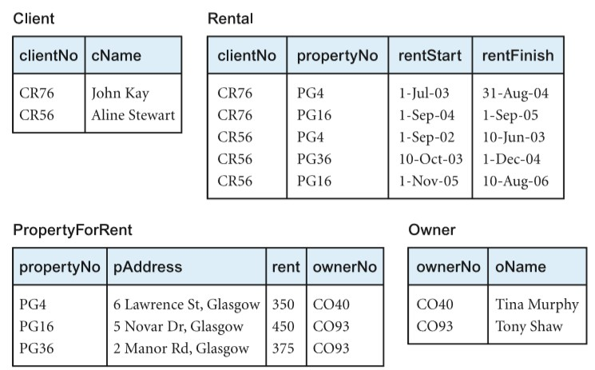
3NF relations
39

Slide 40
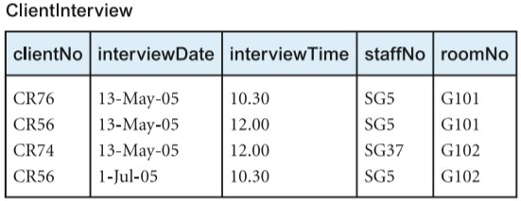
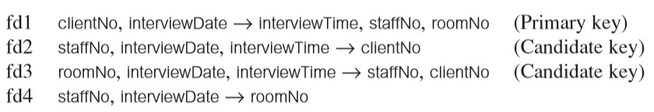
Example 3

Slide 41
(staffNo, interviewDate) is not a candidate key.
But ClientInterview is in 3NF.
Because roomNo is a primary-key attribute being part of the candidate key (roomNo, interviewDate, interviewTime).
This relation is not in BCNF due to the presence of the (staffNo, interviewDate) determinant, which is not a candidate key for the relation.

Slide 42

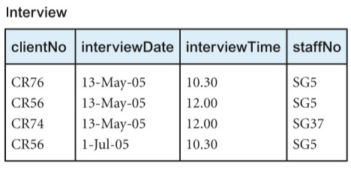
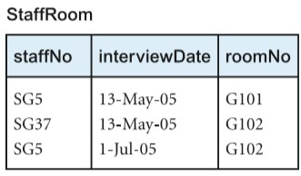
According to BCNF

Slide 43
Exercises
Consider the universal relation R = {A,B,C,D,E,F,G,H,I,J} and the set of functional dependencies
F = { {A, B}→{C}, {A}→{D, E}, {B}→{F}, {F}→{G, H}, {D}→{I,J} }
What is the key for R?
Decompose R into 2NF and then 3NF relations.
Repeat the same exercise for the following different set of functional dependencies
G = {{A,B}→{C},{B,D}→{E,F},{A,D}→{G,H},{A}→{I},{H}→{J} }

Slide 44
Thank You
44

